Slide 1
Proxy Pattern
Zain Ali (2021-SE-23)

Slide 2
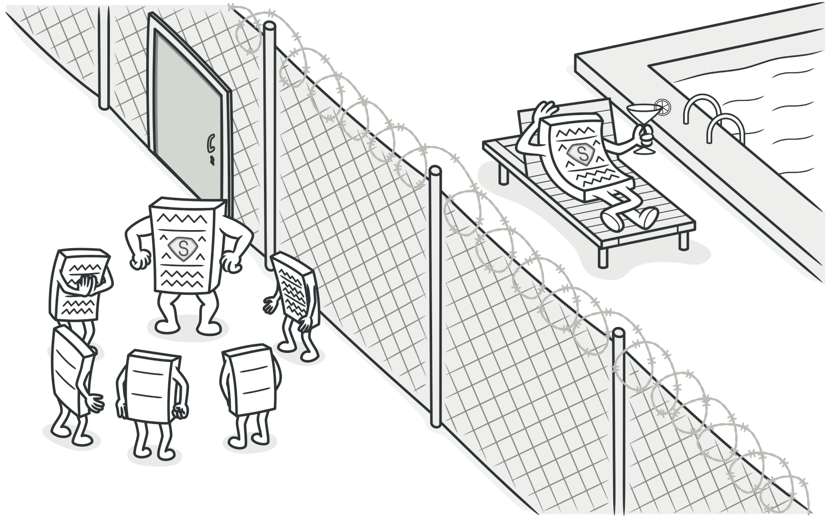
INTRO
Proxy Pattern
The Proxy Pattern is a software design pattern that provides a substitute or placeholder for another object
Why do we use Proxy ?
Access Control
Logging

Slide 3
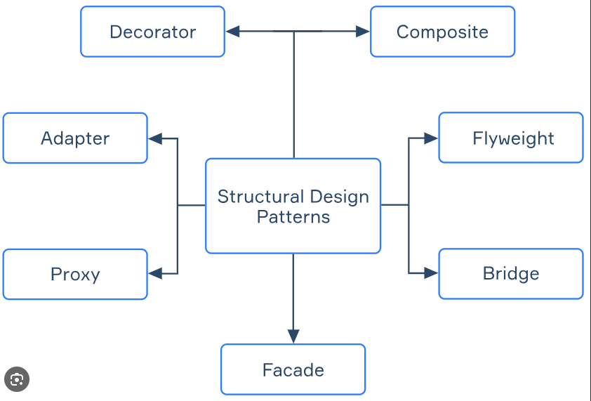
Pattern Type
Proxy is a structural design pattern

Slide 4



Usage of proxy
Virtual Proxy
When we want to create an object that is expensive to create, and we want to create it only when it is needed.
Protection Proxy
When we want to control access to an object, such as when we want to restrict access to certain methods or properties.
Smart Proxy
When we want to add additional functionality to an object, such as logging or caching

Slide 5
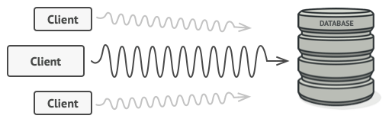
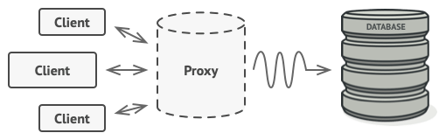
Example
Problem
you have a massive object that consumes a vast amount of system resources. You need it from time to time, but not always.
Problem
Solution
The Proxy pattern suggests that you create a new proxy class with the same interface as an original service object.
Solution

Slide 6
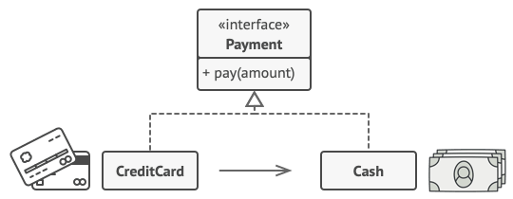
Real World Analogy
A credit card is a proxy for a bank account, which is a proxy for a bundle of cash. Both implement the same interface: they can be used for making a payment. A consumer feels great because there’s no need to carry loads of cash around.
Credit Card

Slide 7
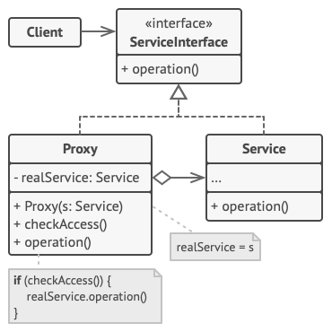
UML
The Service Interface declares the interface of the Service.
The Service is a class that provides some useful business logic.
The Proxy class has a reference field that points to a service object. After the proxy finishes its processing.
The Client should work with both services and proxies via the same interface. This way you can pass a proxy into any code that expects a service object.

Slide 8
THANK YOU
Zain Ali
Zainali.rio@gamil.com

